Slide 1
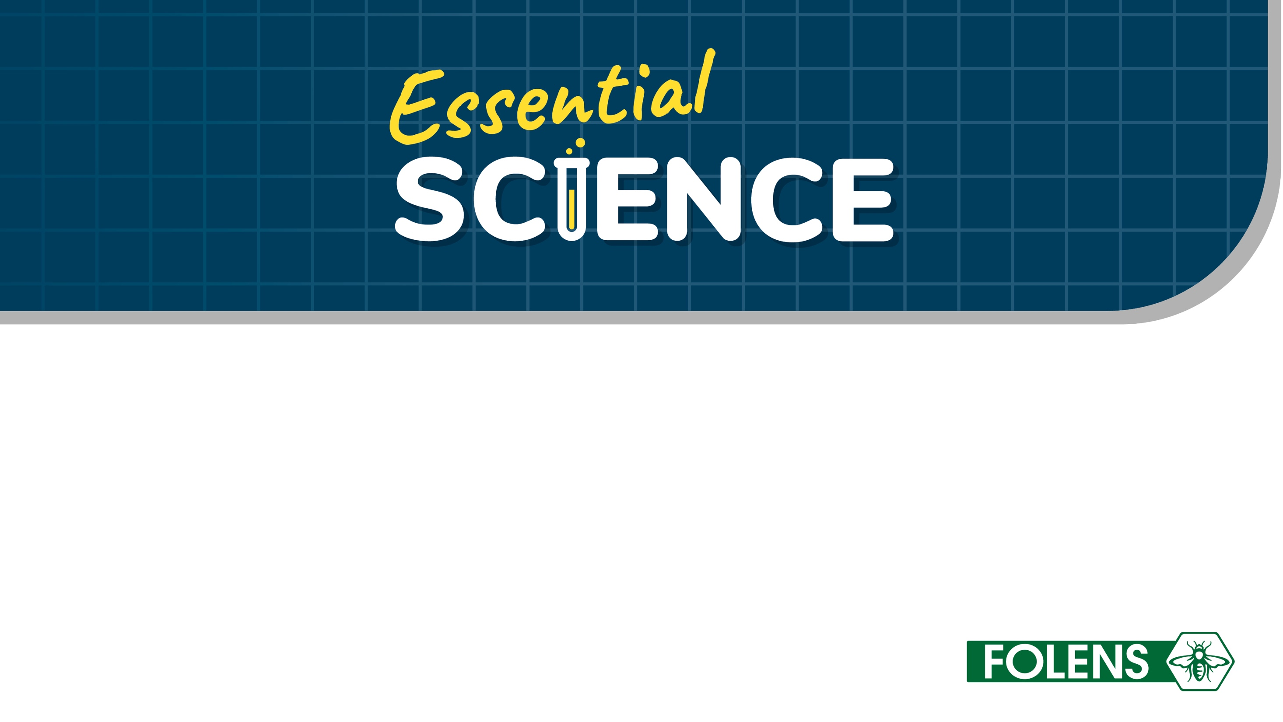
Chapter 9 – Human reproduction
The Biological World – Sustainability

Slide 2

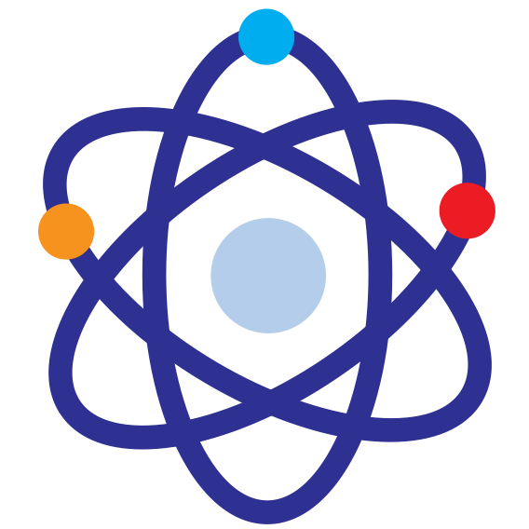
Objectives:
To give students an understanding of the structures and functions of the parts of the male and female reproductive systems
To ensure students know how to explain human reproduction and birth
To introduce students to some medical, ethical and societal issues, including in vitro fertilisation (IVF) and stem cells

Slide 3
Keywords:
Menstrual cycle
Sexual reproduction
Ovulation
Fertilisation
Embryo
Menstruation
Implantation
Placenta
Umbilical cord
Contraception
IVF

Slide 4
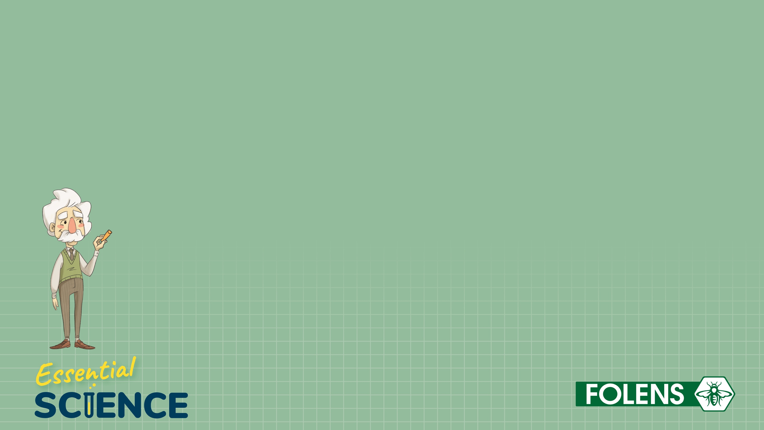
9.1 Reproduction

Slide 5
Reproduction
Reproduction is the process whereby new individuals (offspring) are made from their parents. It is one of the characteristics of life.
Sexual reproduction means that two parents are needed to form new offspring.
Each parent produces a sex cell called a gamete. In humans this is the egg cell (female) and the sperm cell (male).

Slide 6
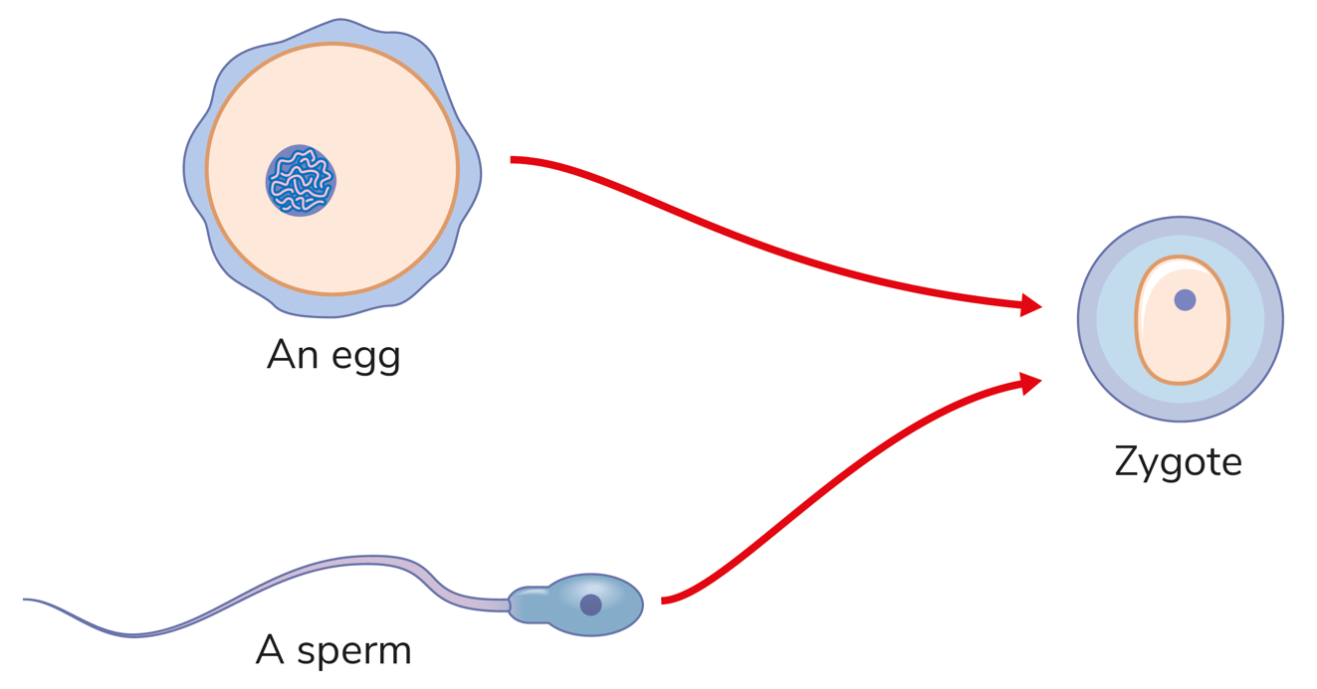
Reproduction
Fertilisation happens when the nucleus of the sperm joins with the nucleus of the egg to form a zygote.
A zygote is a fertilised egg.

Slide 7
9.2 The human male reproductive system

Slide 8
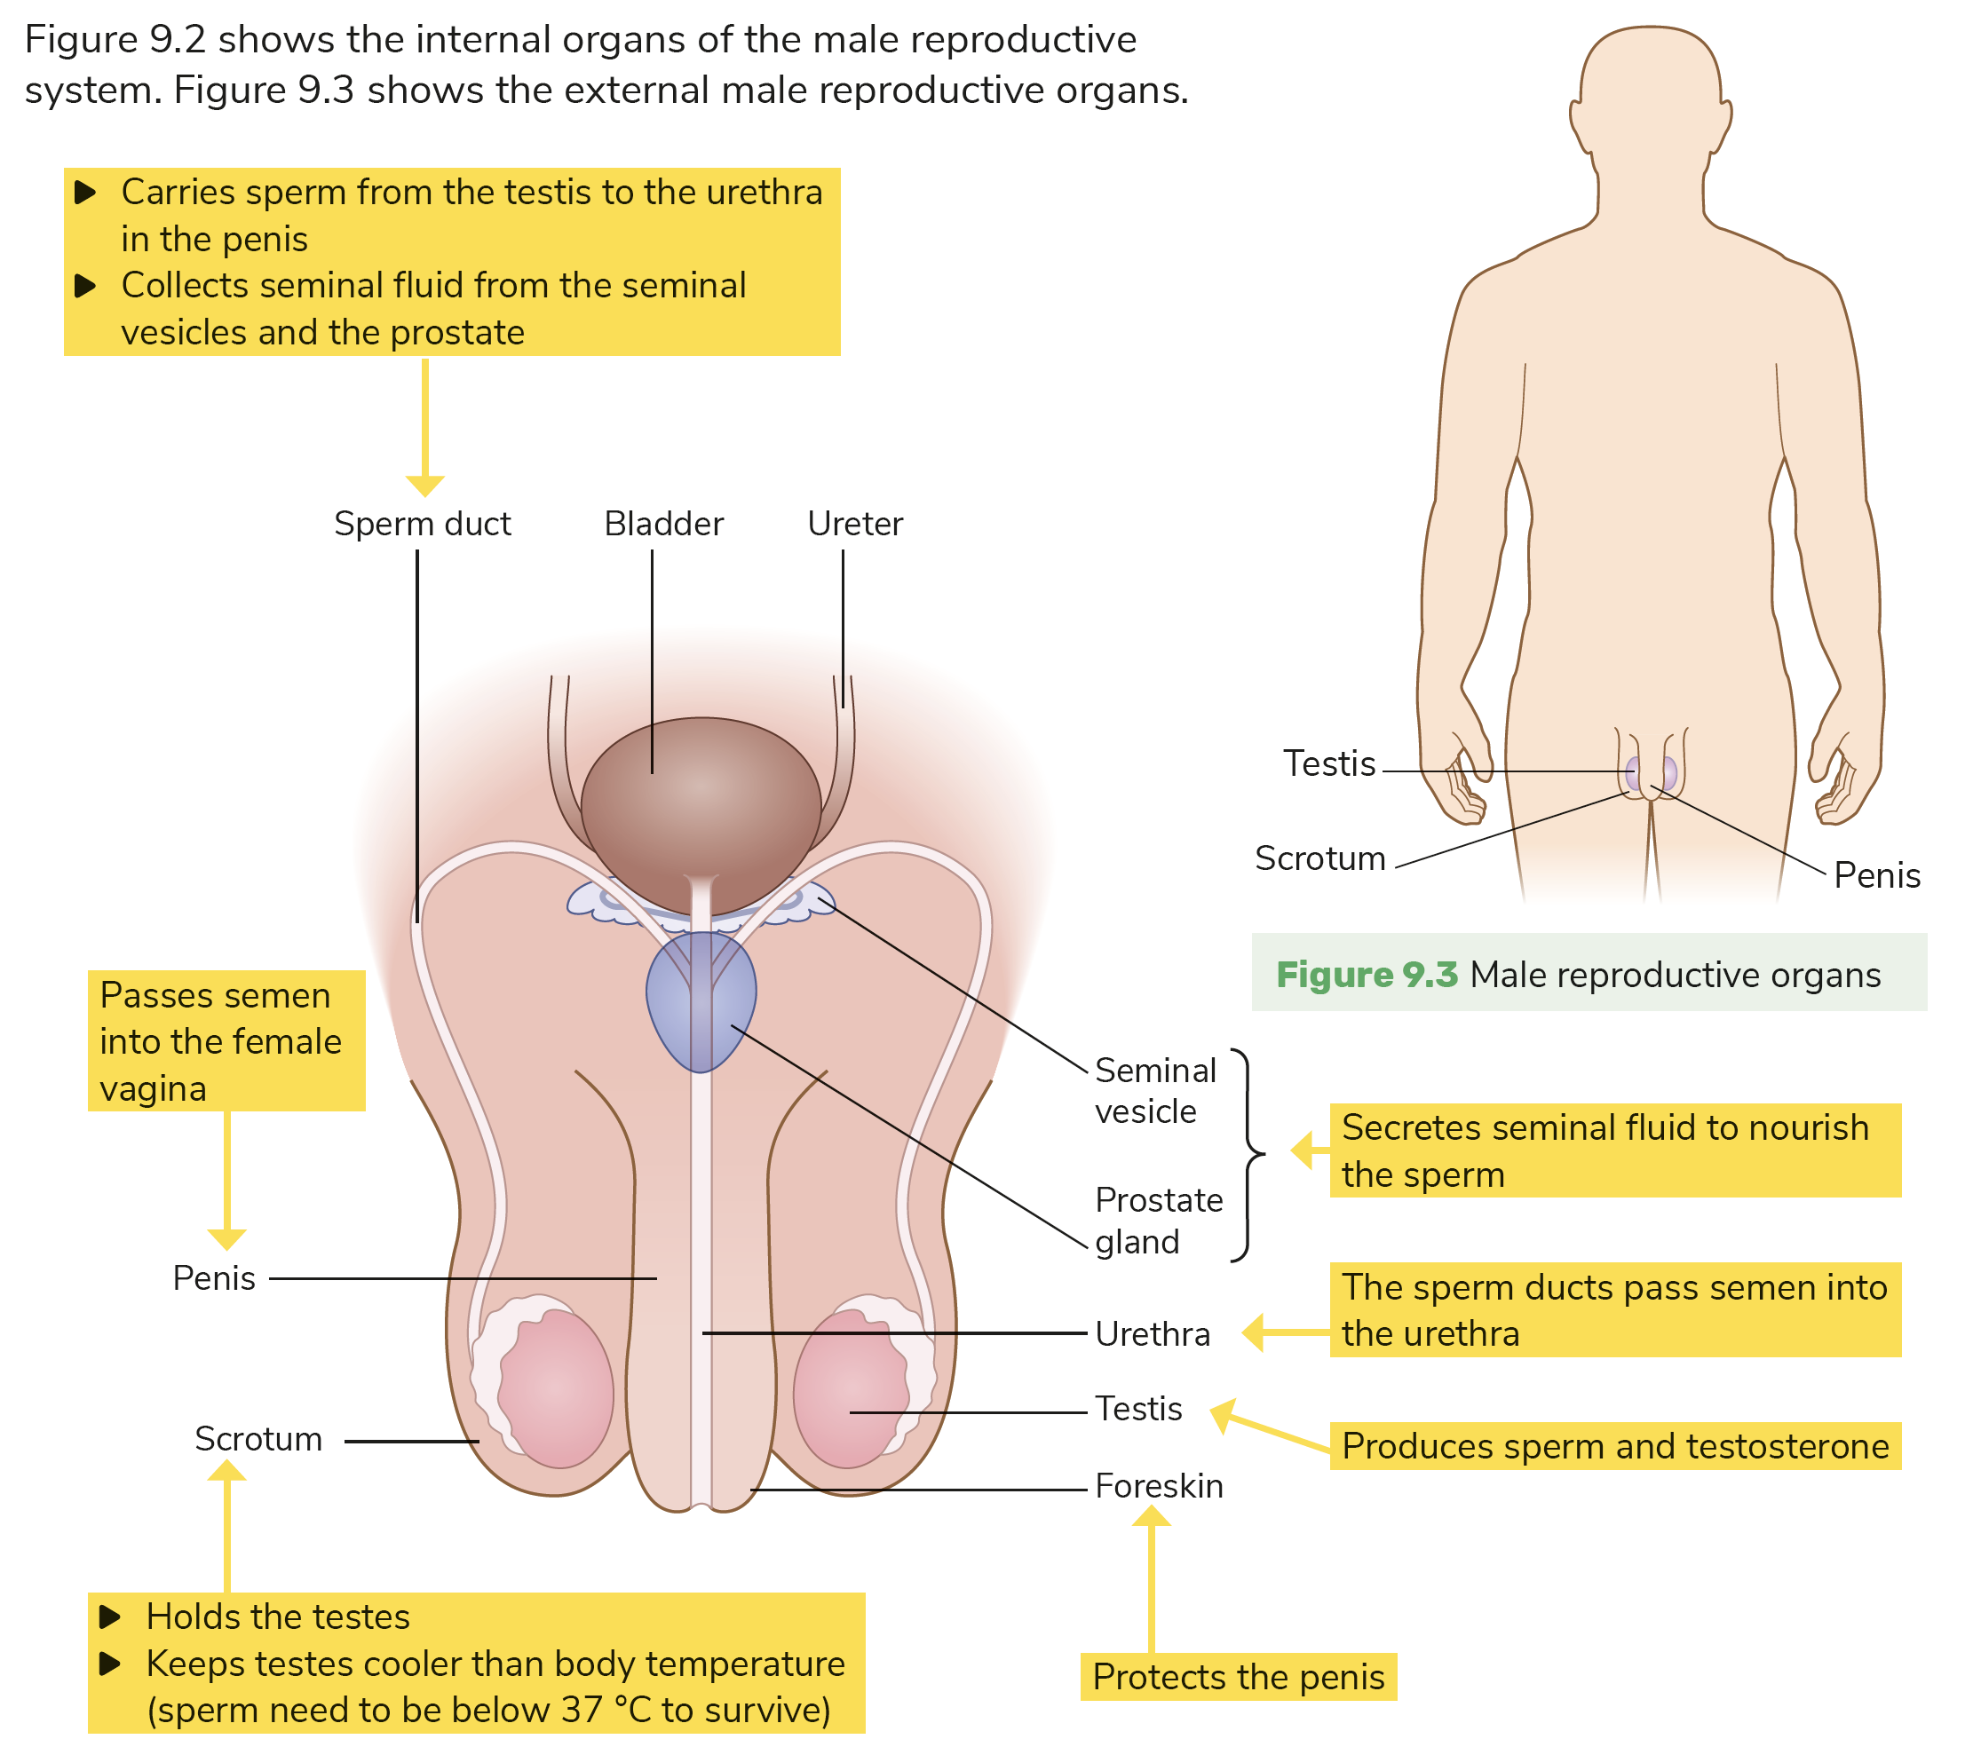
The human male reproductive system

Slide 9
The human male reproductive system
Testis: Produces sperm and testosterone.
Scrotum: Holds the testes outside the body, keeping them at the correct temperature.
Sperm duct: Carries sperm from the testis to the urethra and penis and collects seminal fluid from the seminal vesicles and prostate.
Seminal vesicles and prostate: Secrete seminal fluid to nourish sperm.
Urethra: Carries semen out of the body.
Penis: Passes semen into the female vagina.

Slide 10
Puberty in boys
Puberty is the time when changes happen in a young person’s body and they become sexually mature.
Testosterone, which is produced in the testes, is the hormone that controls secondary male sexual characteristics.

Slide 11
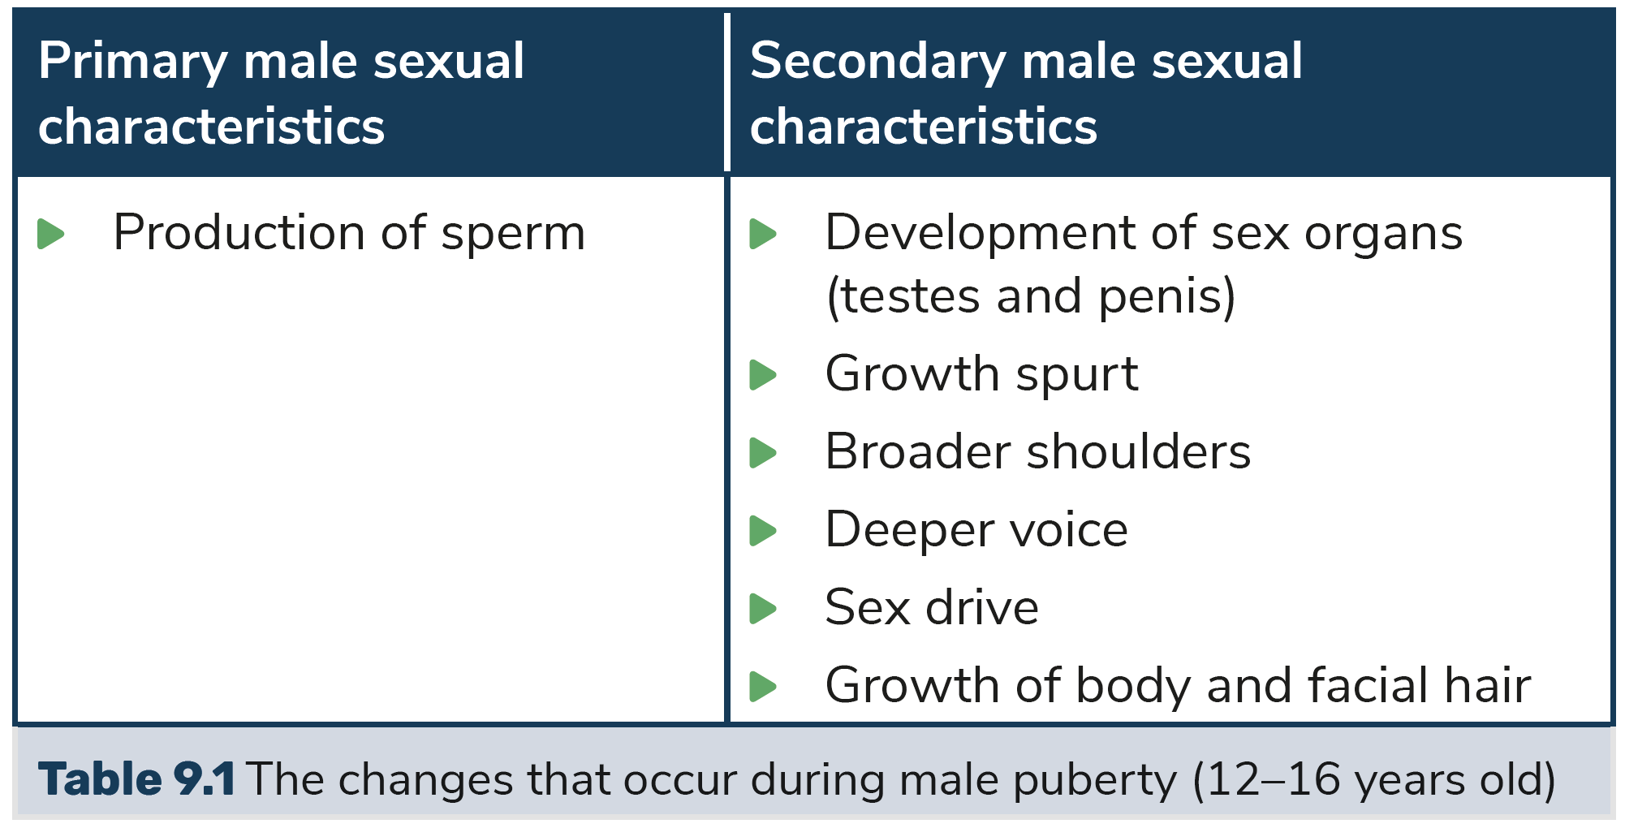
Puberty in boys

Slide 12
9.3 The human female reproductive system

Slide 13
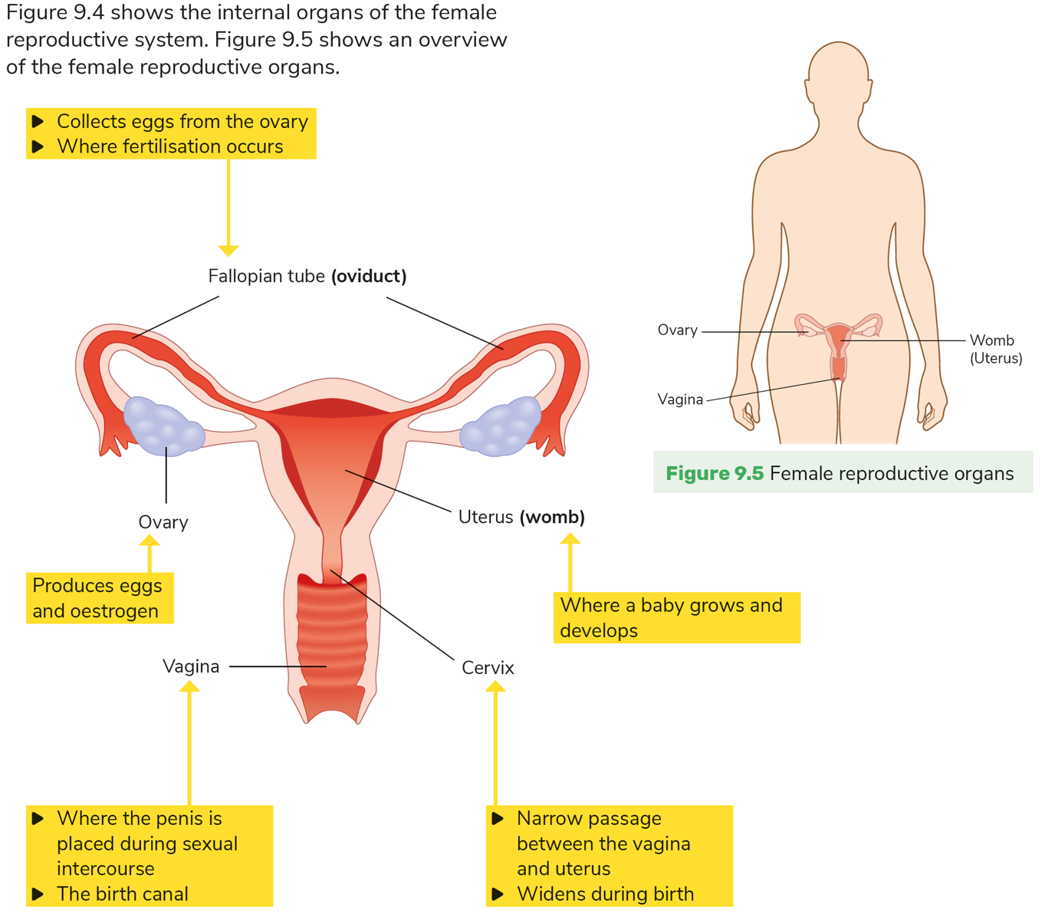
The human female reproductive system

Slide 14
The human female reproductive system
Ovary: Produces eggs and oestrogen.
Fallopian tube: Collects eggs from the ovary. This is where fertilisation occurs.
Uterus: Where the baby grows and develops.
Cervix: Narrow passage between the vagina and the uterus.
Vagina: Where the penis is placed during sexual intercourse; the birth canal.

Slide 15
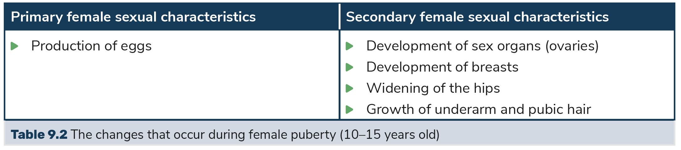
Puberty in girls
Oestrogen, which is produced in the ovaries, is the hormone that controls secondary female sexual characteristics.

Slide 16
9.4 The menstrual cycle

Slide 17
The menstrual cycle
The menstrual cycle is the monthly series of changes a woman’s body goes through to prepare for the possibility of pregnancy. Ovulation and menstruation are part of this cycle.
Ovulation is the time during the menstrual cycle when an egg is released from the ovary into the fallopian tube.
Menstruation is the process of blood and tissue that has built up in the uterus breaking down and leaving the body through the vagina.

Slide 18
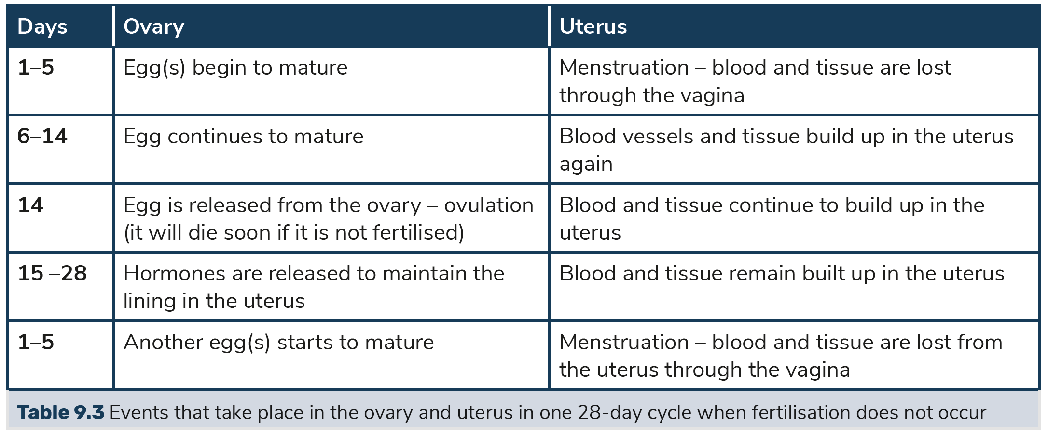
The menstrual cycle

Slide 19
9.5 The fertile period

Slide 20
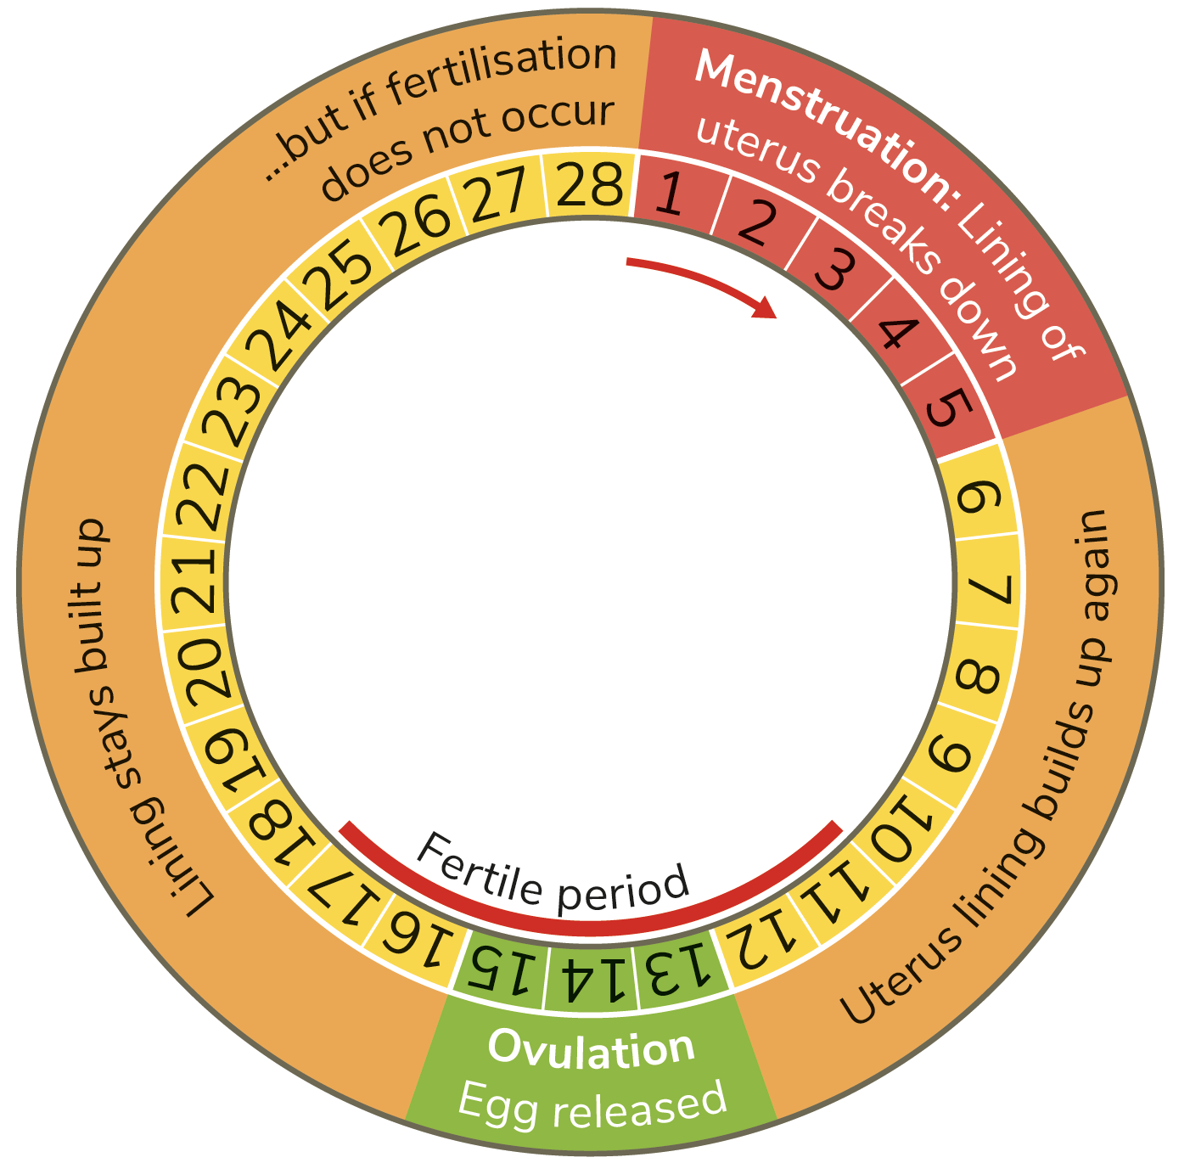
The fertile period
The fertile period occurs during the menstrual cycle. This is the time during the cycle when fertilisation can occur and the female can become pregnant.

Slide 21
9.6 Sexual intercourse and fertilisation

Slide 22
Sexual intercourse and fertilisation
Sexual intercourse occurs when the penis of the man is placed in the vagina of the woman.
For this to happen, the penis becomes stimulated, fills with blood and becomes hard and erect.
The vagina becomes stimulated and produces fluid, which moistens it.
Orgasm in the male leads to ejaculation releasing semen into the vagina.

Slide 23
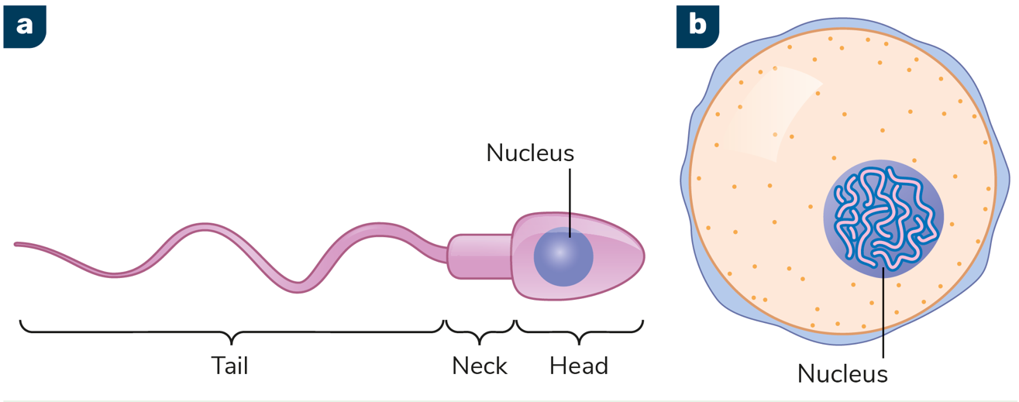
Sexual intercourse and fertilisation
Sperm can swim due to its tail. It will make its way to the egg in the fallopian tube.
Once the sperm reaches the egg, they fuse together. This is called fertilisation.
The resulting cell is called a zygote.

Slide 24
9.7 Implantation and the development of the baby

Slide 25
Implantation and the development of the baby
Embryo is the name given to a baby during the first nine weeks of pregnancy.
Implantation occurs when the embryo attaches to the lining of the womb.
At around nine weeks, the bones start to develop. Foetus is the name given to a baby after the ninth week of pregnancy.
After about 12 weeks, all the body systems of the baby are formed and now the baby needs to grow.

Slide 26
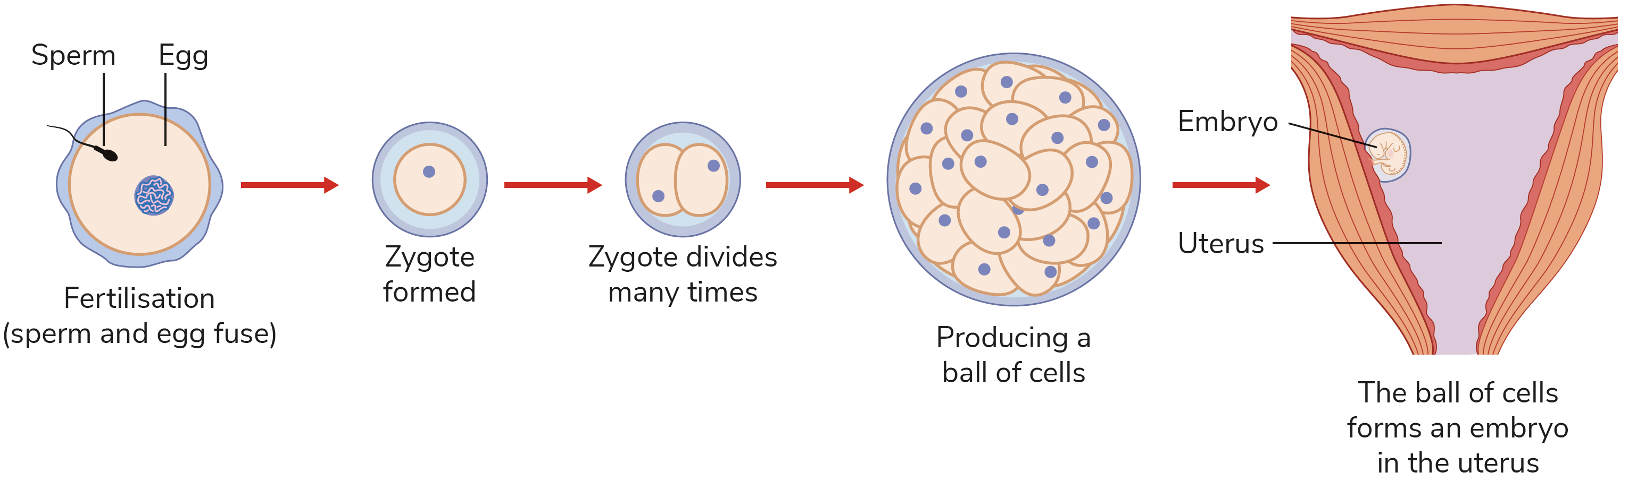
Implantation and the development of the baby

Slide 27
Development of the baby
The baby is protected by amniotic fluid, which is contained within a membrane called the amnion.
The placenta is an organ that fully develops by around week 12.
The placenta passes substances between the mother and baby, such as nutrients, oxygen and waste products.
The umbilical cord connects the baby to the placenta at the navel.

Slide 28
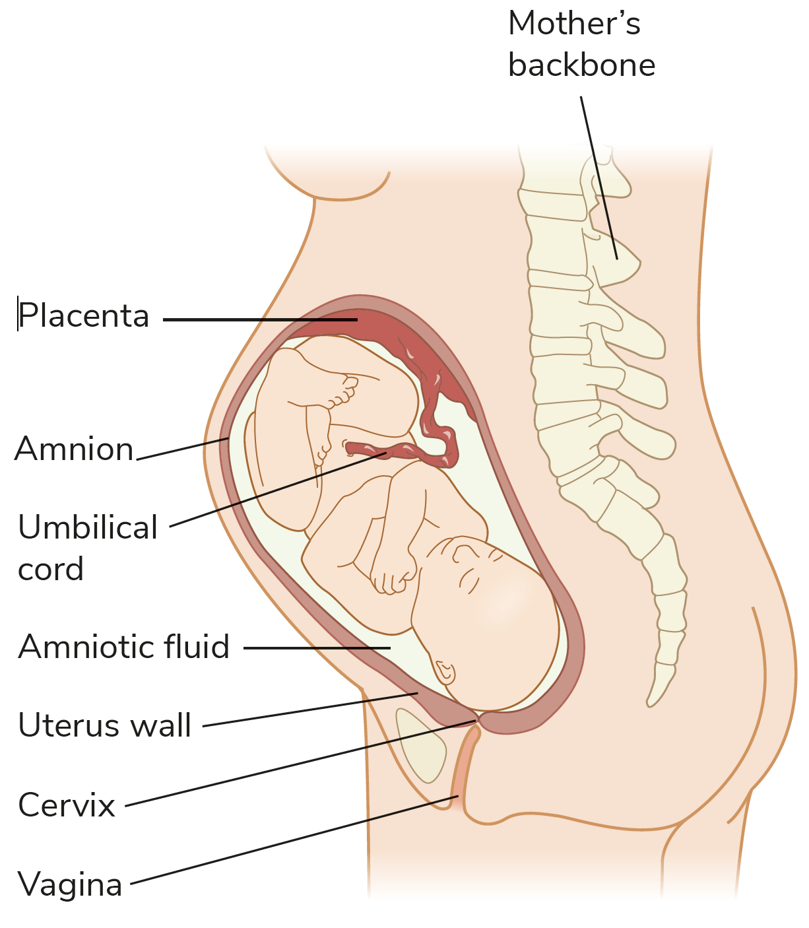
Development of the baby
Q: Why is it important that the placenta keeps the mother’s and the baby’s blood separate?

Slide 29
9.8 Birth

Slide 30
Stages of birth
There are three stages of birth:
Labour: The birth canal widens, the amnion bursts and contractions of the muscles of the uterus begin.
Birth: Contractions continue helping to push the baby out of the birth canal.
Removal of the placenta: This is also known as afterbirth.

Slide 31
9.9 Breastfeeding

Slide 32
Breastfeeding
Once the baby is born, hormones in the mother cause milk production from the mammary glands.
There are many advantages to breastfeeding:
The fluid produced in the first few days, called colostrum, is full of extra nutrients and antibodies.
It provides the right balance of nutrients.
It provides immunity to infection to the baby from the mother.
It promotes a bond between mother and baby.

Slide 33
9.10 Contraception

Slide 34
Contraception
Contraception prevents pregnancy by preventing fertilisation or implantation.
Natural contraception involves careful monitoring of the menstrual cycle and avoiding sexual intercourse during the fertile period.
Artificial contraception involves mechanical methods, which act as barriers to sperm getting to the egg, and chemical methods that use hormones to prevent ovulation.

Slide 35
9.11 In vitro fertilisation (IVF)

Slide 36
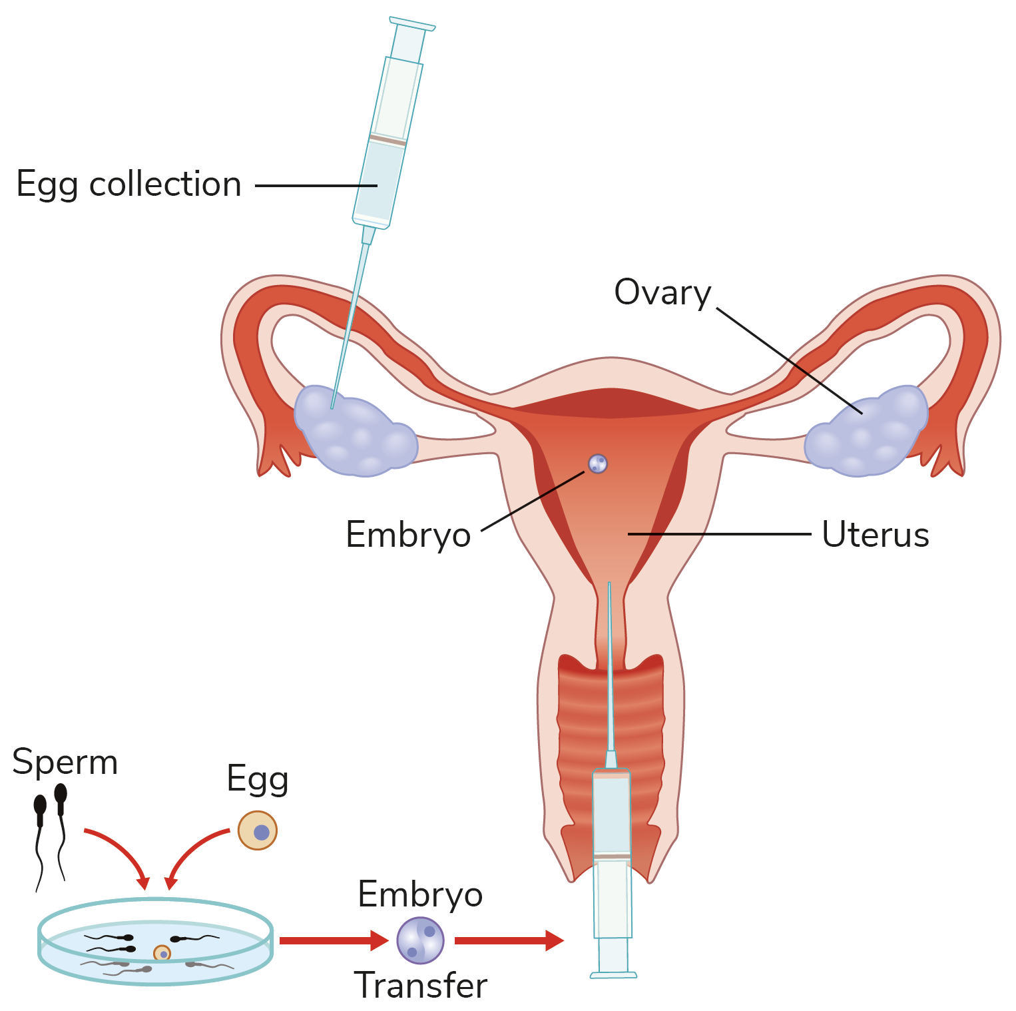
In vitro fertilisation
IVF is where fertilisation is achieved artificially, outside of the body. ‘In vitro’ literally means ‘in glassware’.
The embryos produced by IVF are transferred into the female’s uterus with the hope that they will implant and begin to develop.

Slide 37
Ethics
Ethics is a system of principles concerned with what is good for individuals and society.
Q: Can you think of any ethical concerns that arise in relation to IVF?
Q: Can you think of any ethical issues that arise in relation to embryonic stem cell research?

Slide 38
9.12 Medical issues in human reproduction

Slide 39
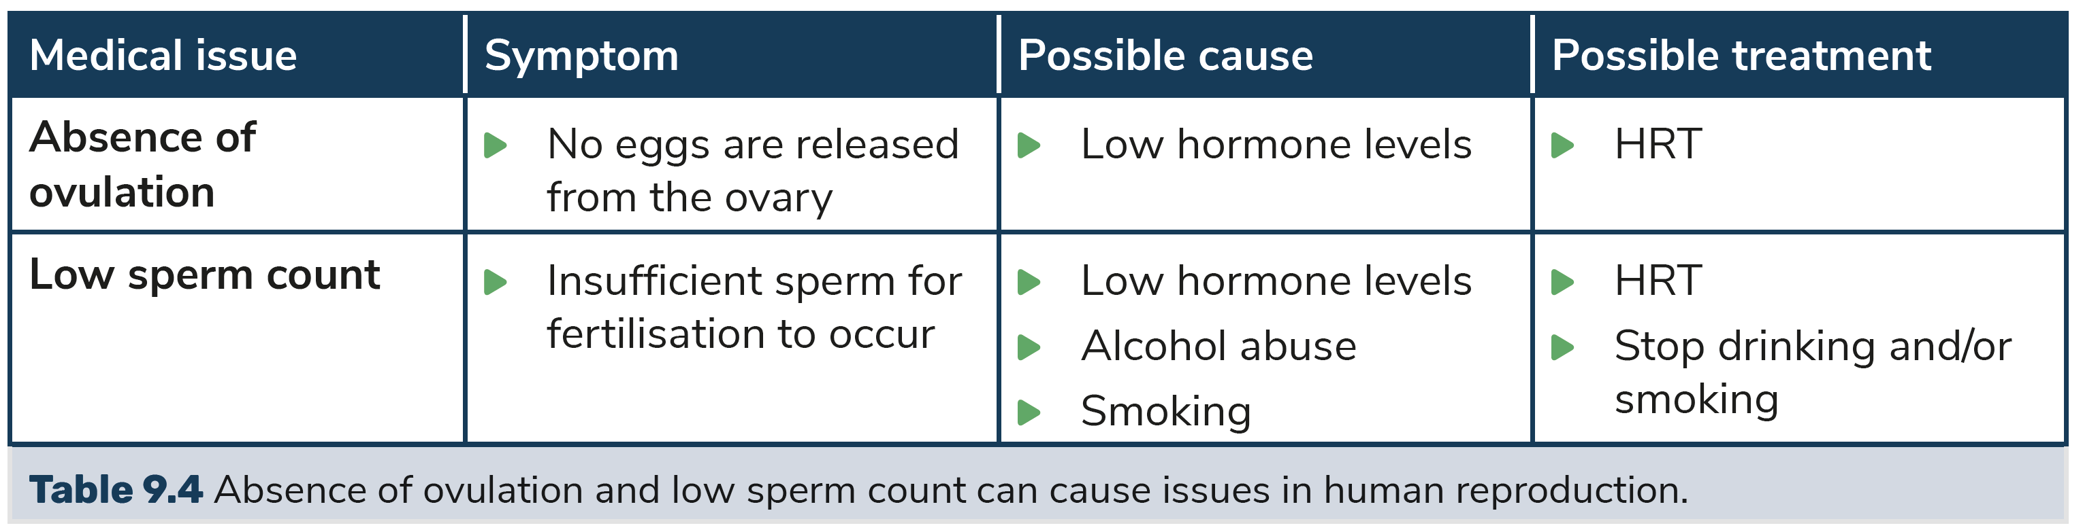
Medical issues in human reproduction
Hormone imbalances that affect the production of gametes can occur in both males and females.
These issues are often treated with hormone replacement therapy (HRT).

Slide 40
9.13 Societal issues in human reproduction

Slide 41
Societal issues in human reproduction
Any method that is used to help couples become pregnant is known as assisted human reproduction (AHR).
AHR is usually very expensive, particularly IVF treatment.
Hormone replacement therapy can also be costly.
Q: Can you think of any societal issues that arise in relation to AHR?

Slide 42
Learning outcomes: Now I am able to…
Tick
Name the parts of the male and female reproductive systems and explain their functions.
Describe the menstrual cycle.
Explain how human reproduction happens.
Explain contraception and give two examples.
Describe an ethical, medical and societal issue in human reproduction.

Slide 43
